Slide 1
Naïve Bayes Classifier
Deepayan Chakrabarti (deepay@utexas.edu)

Slide 2
Naïve Bayes
Earlier we saw the Nearest-Neighbors classifier
Just memorizes data
No parameter fitting
Naïve Bayes
Has parameters
Very simple parameter fitting
Parameters have intuitive meaning

Slide 3
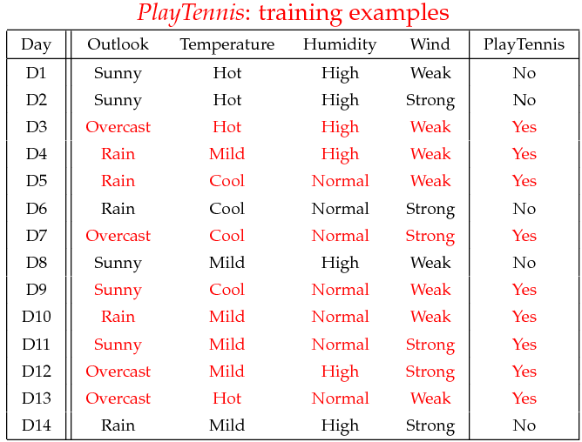
Naïve Bayes

Slide 4
Naïve Bayes
Today
Outlook: Sunny
Temperature: Cool
Humidity: High
Wind: Weak
Nearest-neighbors?
No exact matches
Two close matches
(Sunny, Mild, High, Weak) ➔ Negative
(Sunny, Cool, Normal, Weak) ➔ Positive
What do we do now?

Slide 5
Naïve Bayes
Nearest-neighbors?
Test point: (Sunny, Cool, High, Weak)
Two close matches
(Sunny, Mild, High, Weak) ➔ Negative
(Sunny, Cool, Normal, Weak) ➔ Positive
Problem:
Which matters more?
Temperature (Cool versus Mild)
Humidity (High versus Normal)
Naïve Bayes deals with this.

Slide 6
Naïve Bayes
Given (Sunny, Cool, High, Weak), what is the class?
We will do this in two steps
First step
If someone told me it belongs to the positive class
how surprised would I be?

Slide 7

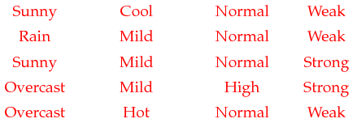
Naïve Bayes
Among the days that are good for tennis what are the chances of a (Sunny, Cool, High, Weak) day?
Only the positive class

Slide 8
Naïve Bayes
Given (Sunny, Cool, High, Weak), what is the class?
We will do this in two steps
First step
Shrink your world to just the positive class
What are the chances of observing the test point?
This is called the “Likelihood” of the positive class
Likelihood of positive class = “How well does the point fit the positive class?”
Repeat for the negative class

Slide 9

Naïve Bayes
Among the days that are bad for tennis what are the chances of a (Sunny, Cool, High, Weak) day?
Only the negative class

Slide 10
Naïve Bayes
Given (Sunny, Cool, High, Weak), what is the class?
We will do this in two steps
First step
What is the likelihood of observing the test point among
the positive class
the negative class?
(we will discuss this shortly)
Second step
Pick the class with the higher likelihood?

Slide 11
Naïve Bayes
9 days
Only the positive class
5 days
Only the negative class

Slide 12
Naïve Bayes
The positive class is almost twice as common as the negative class
The prior
Knowing nothing about the type of day, what are the chances it is a good day for tennis?
9 / (9+5) = 9/14
This prior must be accounted for
Only the positive class
Only the negative class

Slide 13

Naïve Bayes
Y = will customer commit fraud?
Fraud
Safe
X = credit card transactions
Prior: 99.9% of customers are not fraudulent
So our baseline prediction is “Safe”
To say that someone is fraudulent, we need

Slide 14
Naïve Bayes
Given (Sunny, Cool, High, Weak), what is the class?
We will do this in two steps
First step
What is the likelihood of observing the test point among
the positive class
the negative class?
Second step
Pick the class with the higher likelihood? ➔ No
Compute score = likelihood * prior for each class
Pick the class with the higher score

Slide 15
Naïve Bayes
Y = will customer commit fraud?
Fraud
Safe
X = credit card transactions
Prior: 99.9% of customers are not fraudulent
So our baseline prediction is “Safe”
To say that someone is fraudulent, we need
Prior probability of Fraud
Prior probability of Safe

Slide 16
Naïve Bayes
Given (Sunny, Cool, High, Weak), what is the class?
First step
What is the likelihood of observing the test point among
the positive class
the negative class?
Second step
Compute score = likelihood * prior for each class
Pick the class with the higher score
This is actually the optimal prediction!
(if we can calculate the likelihood exactly)

Slide 17
Naïve Bayes
How do we calculate the likelihood?
What are the chances of a (Sunny, Cool, High, Weak) day?
Only the positive class

Slide 18
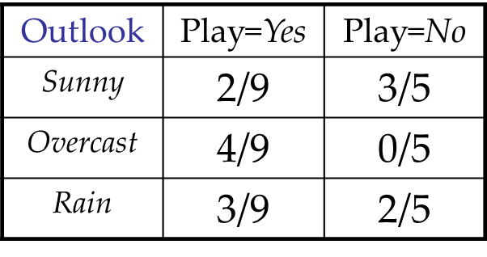
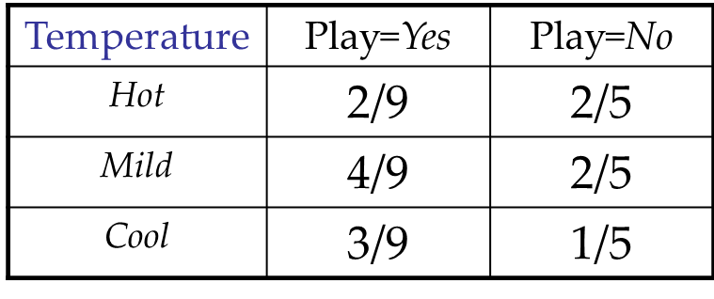
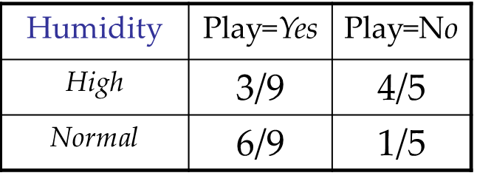
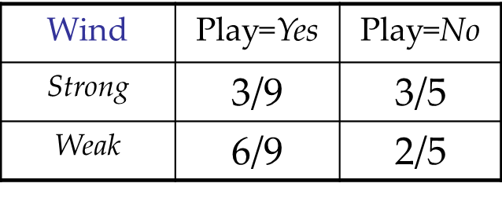
Naïve Bayes
How do we calculate the likelihood?
Naïve Bayes approximates it by looking at each feature independently

Slide 19
Naïve Bayes
What are the chances of a (Sunny, Cool, High, Weak) day?
Likelihood for positive class (Play=Yes)
2/9 * 3/9 * 3/9 * 6/9
0.0164

Slide 20
Naïve Bayes
What are the chances of a (Sunny, Cool, High, Weak) day?
Likelihood for negative class (Play=No)
3/5 * 1/5 * 4/5 * 2/5
0.0384

Slide 21
Naïve Bayes
What are the chances of a (Sunny, Cool, High, Weak) day?
Score = Likelihood * Prior
Positive class ➔ 0.0164 * 9/(9+5) = 0.0105
Negative class ➔ 0.0384 * 5/(9+5) = 0.0137
Predict the class with the higher score ➔ no tennis

Slide 22
Naïve Bayes
Why naïve?
Predict for (Sunny, Hot)
Likelihood = fraction(Sunny) * fraction(Hot)
for each class
Outlook | Temperature | Play Tennis
Sunny | Mild | Yes
Rain | Mild | Yes
Rain | Hot | No
Sunny | Hot | No
… | … | …

Slide 23
Naïve Bayes
Why naïve?
Three features (outlook according to 3 weathermen)
but they all have identical outlook
Outlook (weatherman 1) | Outlook (weatherman 2) | Outlook (weatherman 3) | Temperature | Play Tennis
Sunny | Sunny | Sunny | Mild | Yes
Rain | Rain | Rain | Mild | Yes
Rain | Rain | Rain | Hot | No
Sunny | Sunny | Sunny | Hot | No
… | … | … | … | …

Slide 24
Naïve Bayes
Why naïve?
Predict for (Sunny, Sunny, Sunny, Hot)
Likelihood?
fraction(Sunny) * fraction(Sunny) * fraction(Sunny) * fraction(hot)
Outlook becomes far more important than temperature
Outlook (weatherman 1) | Outlook (weatherman 2) | Outlook (weatherman 3) | Temperature | Play Tennis
Sunny | Sunny | Sunny | Mild | Yes
Rain | Rain | Rain | Mild | Yes
Rain | Rain | Rain | Hot | No
Sunny | Sunny | Sunny | Hot | No
… | … | … | … | …

Slide 25
Naïve Bayes
Why naïve?
It assumes independent features
When features are correlated, it can make mistakes
Identical outlooks by the three weathermen was an extreme case of correlated features

Slide 26
Summary
Naïve Bayes has a very simple parameter fitting method
Just count how often a feature value occurs in each class
During testing
Compute likelihood of positive class
Multiply the fraction of times the features observed in the test data occurred in the positive training examples
Ditto for the negative class
Multiply by the prior to get the score
Pick the class with the highest score

Slide 27
Acknowledgements
Slides by Ke Chen at the Univ. of Manchester.

Slide 28
Naïve Bayes
Given (Sunny, Cool, High, Weak), what is the class?
We will do this in two steps
First step
If someone told me it belongs to the positive class
how surprised would I be?
Shrink your world to just the positive class
What are the chances of observing the test point?
This is called the “Likelihood” given the positive class
Repeat for the negative class

Slide 29
Naïve Bayes
Y = will customer commit fraud?
Fraud
Safe
X = credit card transactions
Prior: 99.9% of customers are not fraudulent
Positive class
Score = likelihood of fraud * 0.001
Negative class
Score = likelihood of no fraud * 0.999
To predict that someone is fraudulent
the likelihood of fraud must be high enough to overcome its tiny prior

